Slide 1

Time series and its application

Slide 2
Objectives
Understand time series data
Understand the time series analysis
Understand the application of time series analysis
Time series and its application

Slide 3
Definition Time Series data
Time series data is a type of data where observations are collected and recorded over time.
In a time series, each data point represents a measurement or an observation taken at a specific point in time or over a sequence of time intervals.
Time series data is commonly used in various fields, including finance, economics, signal processing, weather forecasting
Time series and its application

Slide 4
Characteristics of time series data
Temporal Ordering: The data points in a time series are ordered chronologically, with each observation associated with a specific time or time interval.
Dependency on Time: The value of a data point at a given time is often dependent on its previous values. Time series data exhibits patterns, trends, and seasonality, which can be analyzed to make predictions or gain insights.
Time series and its application

Slide 5
Characteristics of time series data
Regular or Irregular Intervals: Time series data can have regular intervals (e.g., hourly, daily, monthly) or irregular intervals, depending on the nature of the data collection process.
Components: Time series data can be decomposed into several components, including trend, seasonality, cyclic patterns, and irregular fluctuations.
Time series and its application

Slide 6
Examples of time series data
Stock Prices: Daily closing prices of a stock over a period of time.
Temperature Readings: Hourly or daily temperature measurements over the course of a year.
Economic Indicators: Quarterly GDP (Gross Domestic Product) data over several years.
Web Traffic: Hourly or daily website visit counts.
Energy Consumption: Monthly electricity usage data.
Time series and its application

Slide 7
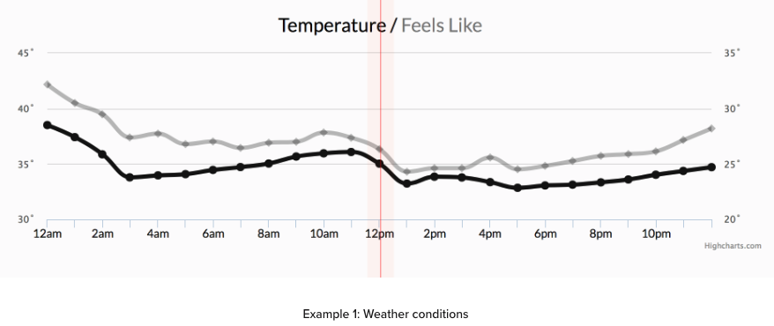
Time Series data
Example of time series data
Time series and its application

Slide 8
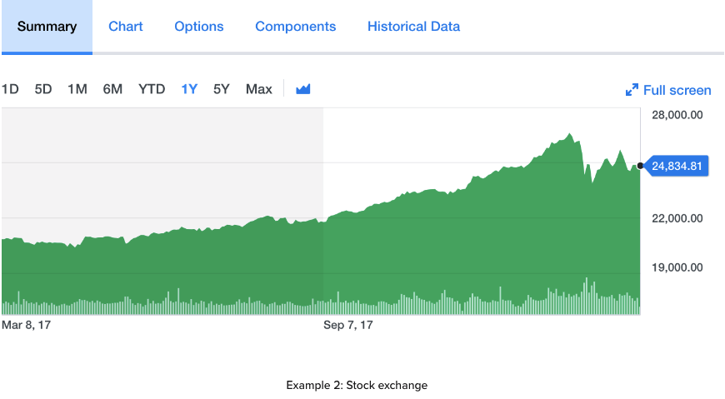
Time Series data
Example of time series data
Time series and its application

Slide 9
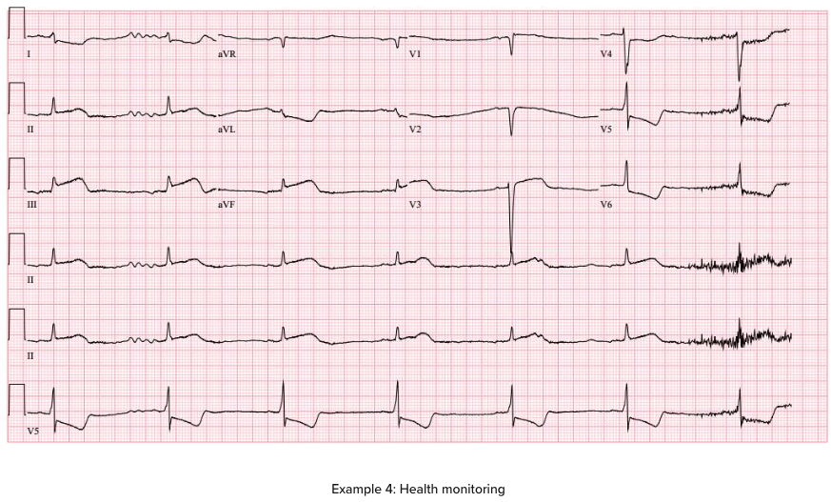
Time Series data
Example of time series data
Time series and its application

Slide 10
Time Series Analysis
Time series analysis is a statistical technique used to analyze and interpret data points collected over time.
It involves studying the patterns, trends, and behaviors that emerge from sequential observations of a variable or a set of variables.
The primary goal of time series analysis is often to understand the underlying structure of the data, make predictions about future values, and gain insights for decision-making
Time series and its application

Slide 11
Time Series Analysis methods
Exploratory Data Analysis (EDA):
  Perform exploratory data analysis to understand the basic characteristics of the time series. This includes plotting time series graphs, calculating descriptive statistics, and identifying any apparent patterns or trends.
Trend Analysis:
  Time series data often contains a long-term upward or downward movement known as a trend. Trend analysis helps in identifying and understanding these overall patterns, allowing analysts to separate the underlying trend from other components.
Time series and its application

Slide 12
Time Series Analysis methods
Seasonal Decomposition:
  Many time series exhibit seasonal patterns or cycles. Seasonal decomposition involves breaking down a time series into its individual components, such as trend, seasonality, and residual (the remainder after removing trend and seasonality).
Autocorrelation and Partial Autocorrelation:
  Autocorrelation measures the correlation between a time series and its own lagged values. Understanding autocorrelation helps in identifying how past observations influence future ones. Partial autocorrelation is similar but measures the direct relationship between observations at two distinct time points, controlling for the influence of other time lags.
Time series and its application

Slide 13
Time Series Analysis methods
Machine Learning Models:
  More advanced time series analysis may involve machine learning techniques such as neural networks, support vector machines, or ensemble methods for prediction and classification tasks.
Forecasting:
  Time series analysis is often used for forecasting future values based on historical patterns. This can be done using the models mentioned above, and the accuracy of forecasts can be evaluated using various metrics.
Time series and its application

Slide 14
Time Series Analysis Applications
Financial Forecasting:
  Predicting stock prices.
  Forecasting economic indicators.
  Analyzing and predicting currency exchange rates.
Economic Analysis:
  Analyzing and forecasting GDP (Gross Domestic Product) trends.
  Monitoring unemployment rates over time.
  Studying inflation patterns.
Time series and its application

Slide 15
Time Series Analysis Applications
Energy Consumption and Demand Forecasting:
  Predicting electricity, water, or gas consumption.
  Forecasting demand for energy resources.
Weather and Climate Analysis:
  Analyzing temperature, precipitation, and other meteorological data.
  Forecasting weather patterns and extreme events.
Time series and its application

Slide 16
Time Series Analysis Applications
Healthcare and Epidemiology:
  Monitoring the spread of diseases over time.
  Forecasting patient admissions in hospitals.
  Analyzing trends in public health data.
Manufacturing and Supply Chain:
  Predicting demand for products.
  Monitoring production processes over time.
  Analyzing supply chain disruptions and delays.
Time series and its application

Slide 17
Time Series Analysis Applications
Web Analytics:
  Analyzing website traffic patterns.
  Predicting user engagement over time.
Marketing and Sales:
  Forecasting sales trends.
  Analyzing the impact of marketing campaigns over time.
Time series and its application

Slide 18
Time Series Analysis Applications
Traffic and Transportation:
  Predicting traffic congestion patterns.
  Analyzing public transportation ridership over time.
Social Media Analysis:
  Studying trends in social media activity.
  Analyzing user engagement over time.
Time series and its application

Slide 19
Time Series Analysis Applications
Environmental Monitoring:
  Analyzing pollution levels over time.
  Studying the impact of climate change on ecosystems.
Telecommunications:
  Analyzing call volumes and network traffic.
  Predicting network performance and outages.
Time series and its application

Slide 20
Summary
Understand time series data
Understand the time series analysis
Understand the application of time series analysis
Time series and its application

Slide 21
Q & A
Time series and its application

